Slide 1
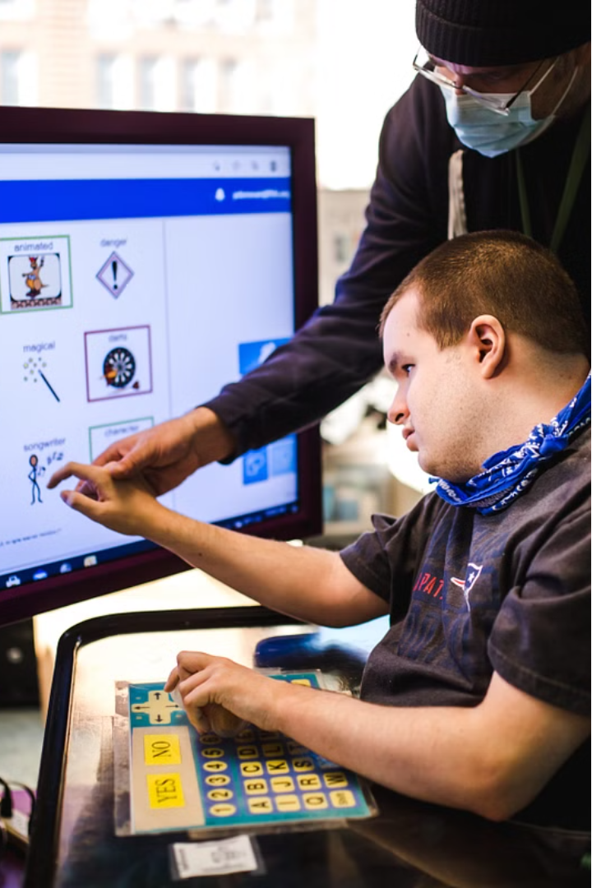
Introducing the Object Detector Stick
The Object Detector Stick is an innovative assistive device designed to enhance the independence and safety of blind and visually impaired individuals. This compact, yet powerful, device combines advanced ultrasonic technology with intuitive haptic feedback to help users navigate their surroundings with confidence.

Slide 2
Components of the Object Detector Stick
Arduino Microcontroller
Ultrasonic Sensor
Vibration Motor
High-frequency sound waves detect the presence and distance of nearby objects, providing crucial spatial awareness.
Strategically placed vibration motors deliver haptic feedback, alerting the user to the proximity of obstacles.
The heart of the device, the Arduino board, processes sensory data and controls the various components.

Slide 3

How the Object Detector Stick Works
Ultrasonic Scanning
1
The device continuously scans the environment using high-frequency sound waves, detecting the presence and distance of nearby objects.
2
Distance Calculation
The time it takes for the sound waves to reflect back is used to calculate the distance to detected objects.
Haptic Feedback
3
The vibration motors provide intuitive tactile feedback, informing the user of the proximity and location of obstacles.

Slide 4
Benefits of the Object Detector Stick
1
Enhanced Mobility
2
Increased Independence
Users can navigate their surroundings with greater confidence, reducing the risk of collisions and falls.
The device empowers blind and visually impaired individuals to explore their environments independently.
3
Improved Safety
4
Reduced Anxiety
The Object Detector Stick helps users avoid hazards and navigate unfamiliar or changing environments safely.
The device's intuitive feedback helps alleviate the stress and uncertainty often associated with mobility challenges.

Slide 5
Customization and Personalization Options
Adjustable Strap
Customizable Vibration Patterns
The device's wrist strap can be easily adjusted to ensure a comfortable and secure fit for users of all sizes.
Users can personalize the vibration patterns to suit their individual preferences and needs.
Companion App
Interchangeable Sensors
A dedicated mobile app allows users to customize settings, monitor device performance, and receive updates.
The modular design enables users to swap out sensors, such as infrared or laser-based, to suit their environment.

Slide 6
Comparison to Other Assistive Technologies
White Canes
Guide Dogs
GPS Navigation Apps
The Object Detector Stick offers greater range and advanced obstacle detection capabilities compared to traditional white canes.
The device provides an alternative solution for individuals who may not have access to or prefer not to use guide dogs.
The Object Detector Stick complements GPS-based navigation by providing real-time environmental awareness and haptic feedback.

Slide 7




Pricing and Availability
Affordable
Global Availability
Warranty Protection
Customer Support
The Object Detector Stick is priced competitively to ensure accessibility for a wide range of users.
The device is available for purchase through a network of authorized retailers and online platforms.
All Object Detector Sticks come with a comprehensive warranty to ensure long-term reliability and peace of mind.
Dedicated customer service teams are available to provide guidance and troubleshooting assistance.

Slide 8
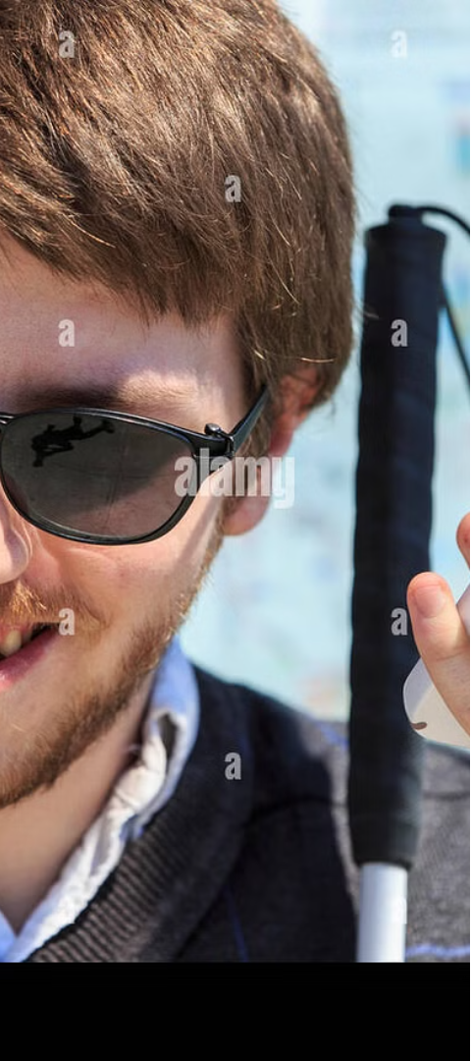



Empowering Independence with the Object Detector Stick
Enhance Mobility
The Object Detector Stick helps users navigate their surroundings with greater confidence and safety.
Promote Independence
This innovative device empowers blind and visually impaired individuals to explore their environments independently.
Improve Quality of Life
By reducing the anxiety and stress associated with mobility challenges, the Object Detector Stick enhances users' overall quality of life.

